Slide 1
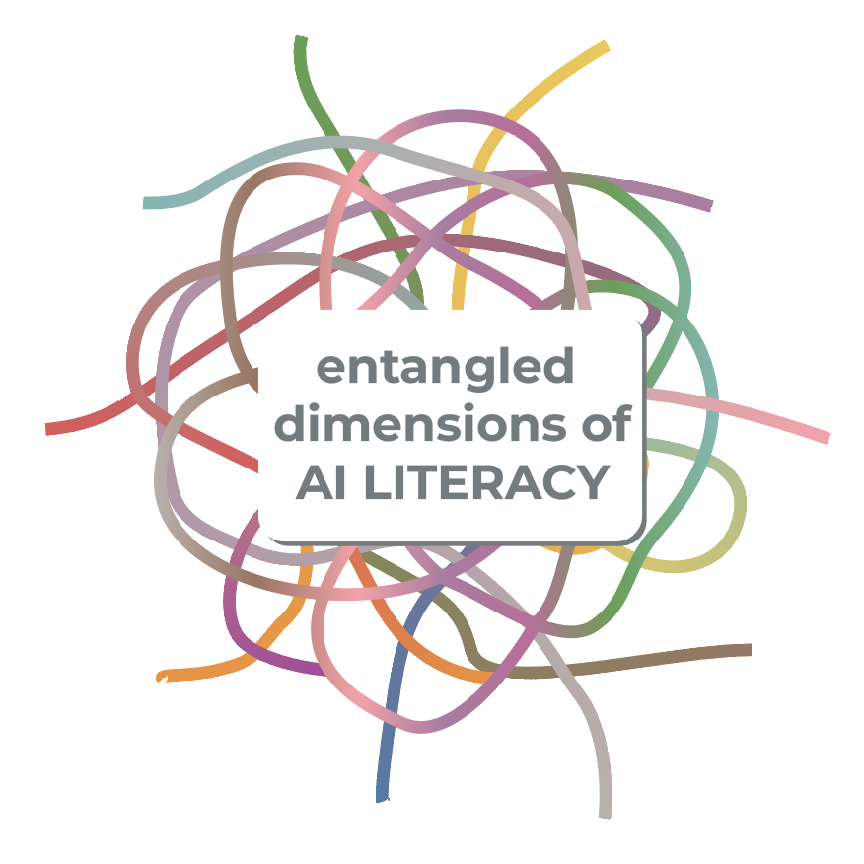
AI is not a separate domain to master but part of an already entangled landscape of learning,
technology, and society.
This framework maps ten entangled dimensions of AI literacy
not as isolated skills, but as overlapping concerns
that shape how we learn, relate,
and make meaning in AI-mediated worlds.
This framework offers a starting point for navigating complexity, and for thinking critically about the roles AI plays across disciplines, institutions, and everyday life.
Swipe through to explore each dimension.
Rachel Horst, PhD

Slide 2
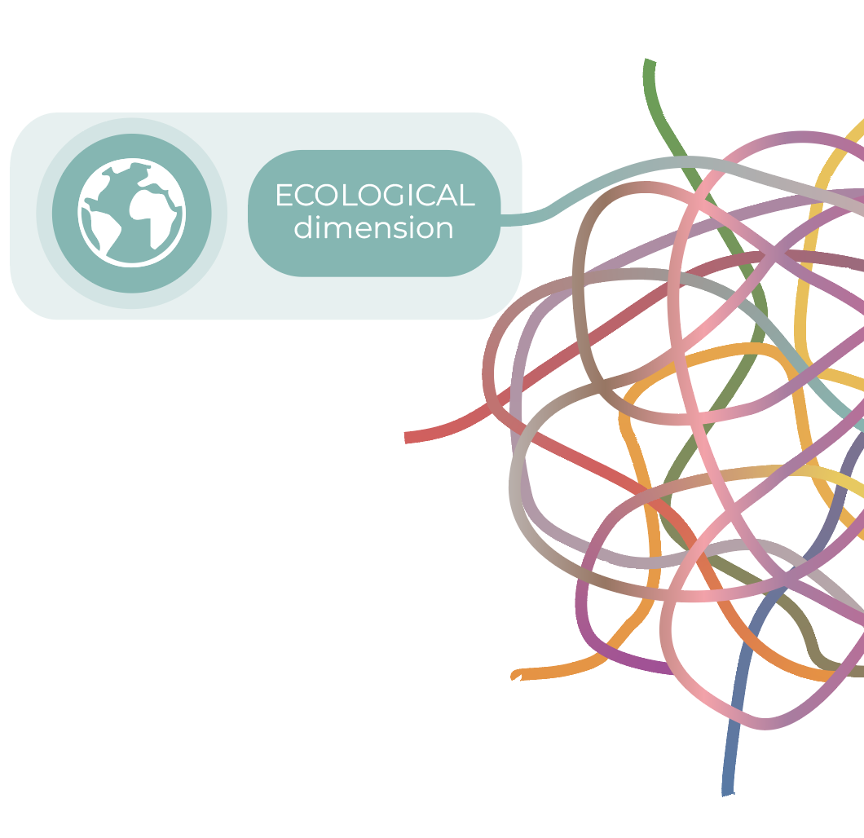
Every AI system is entangled with ecological systems—from extraction and energy use to waste and emissions.
PROVOCATION
How do we weigh the environmental impacts of AI against its promises?
What risks, harms, and extractive practices are too often left out of the conversation?
?
Rachel Horst, PhD

Slide 3
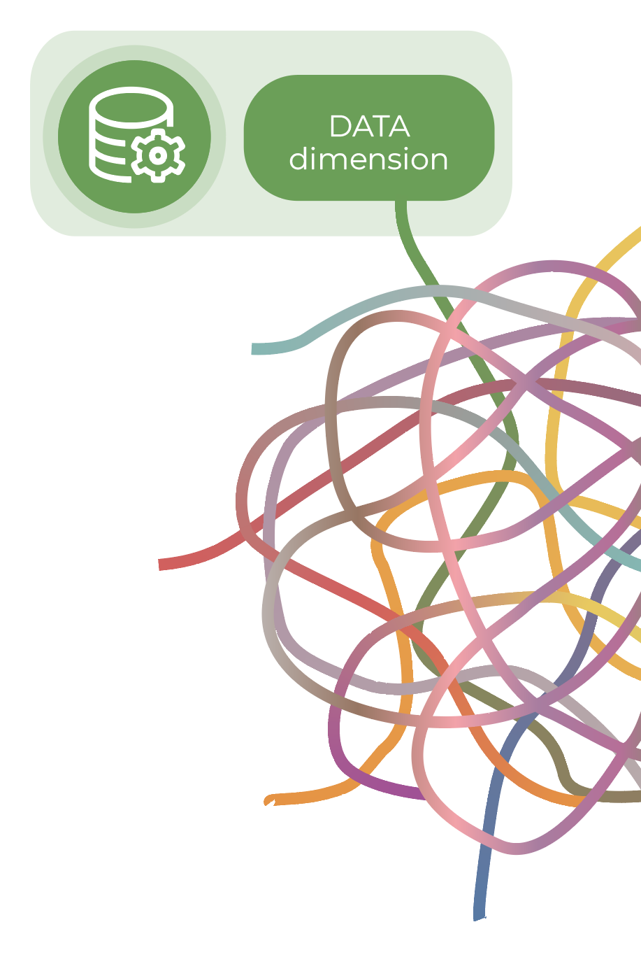
AI systems are shaped by the data they’re trained on including how the data is collected, labeled, structured, and selected.
PROVOCATION
?
How do practices of data collection reflect and reproduce existing power structures?
Rachel Horst, PhD

Slide 4
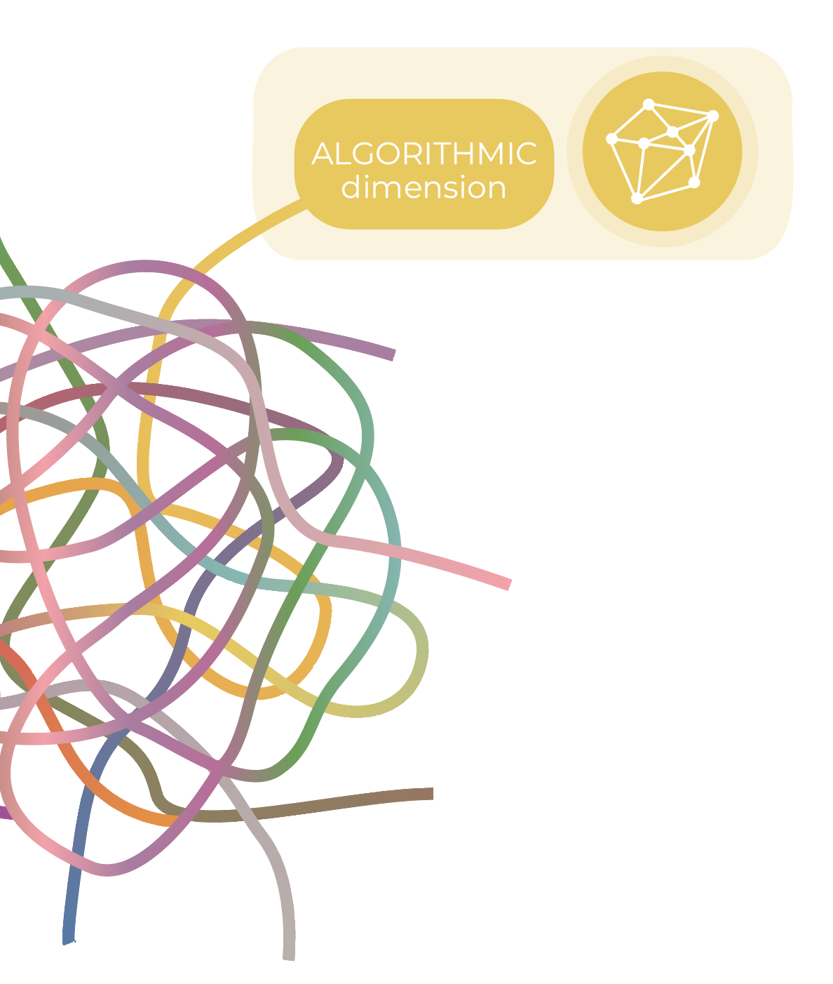
Algorithms implement logic to classify, predict, and automate decisions, increasingly structuring how we navigate, consume, and engage with the world.
PROVOCATION
?
How do algorithmic systems shape not just what we encounter in our daily lives, but what we come to value, believe, and know?
Rachel Horst, PhD

Slide 5
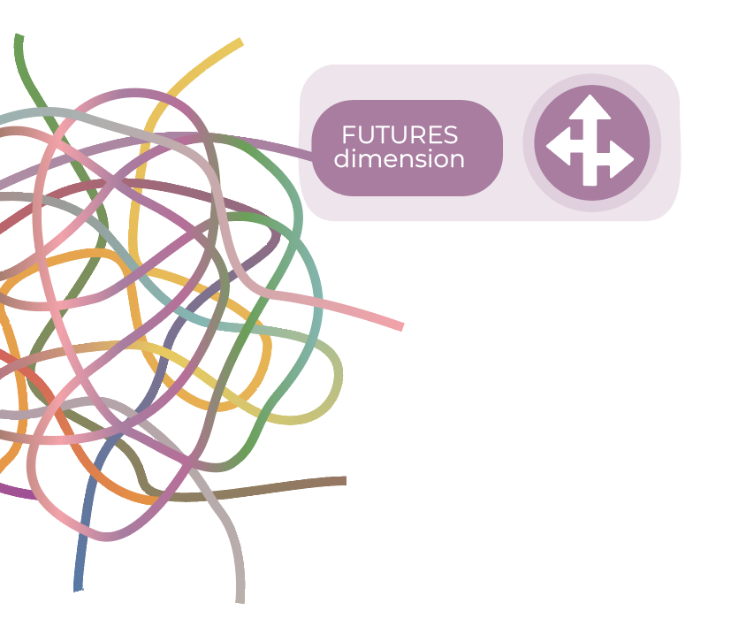
AI technologies are entangled with the futures we plan for, invest in, and believe are possible.
PROVOCATION
What futures are enabled and constrained in the design and deployment of AI?
How can we create space for alternative, speculative, or radically different futures to emerge?
?
Rachel Horst, PhD

Slide 6
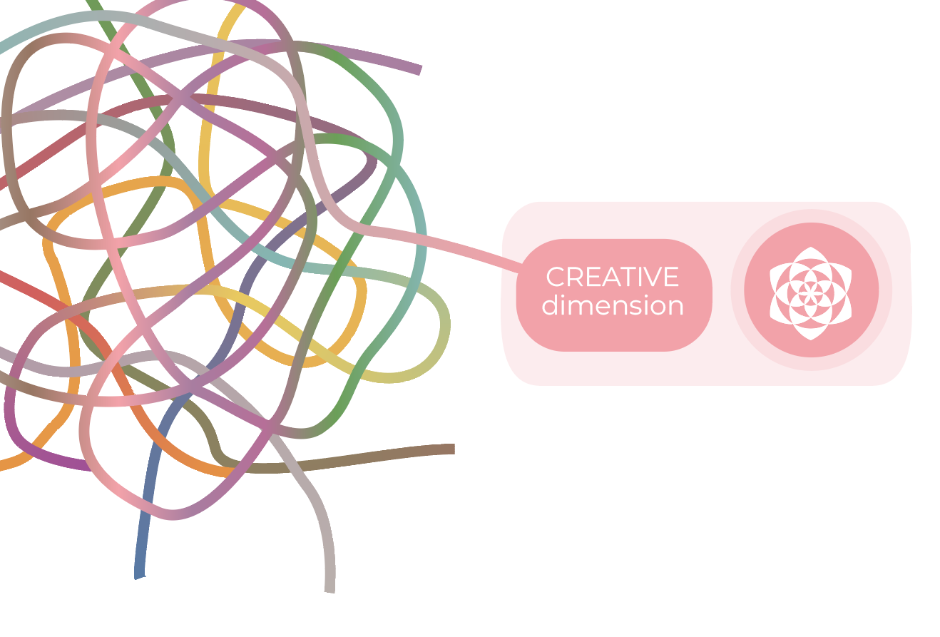
AI-enabled creativity complicates established boundaries and processes of authorship, expression, and invention.
PROVOCATION
Where does human intention end and algorithmic patterning begin and how might we intentionally shift, blur, or redraw those boundaries?
?
Rachel Horst, PhD

Slide 7
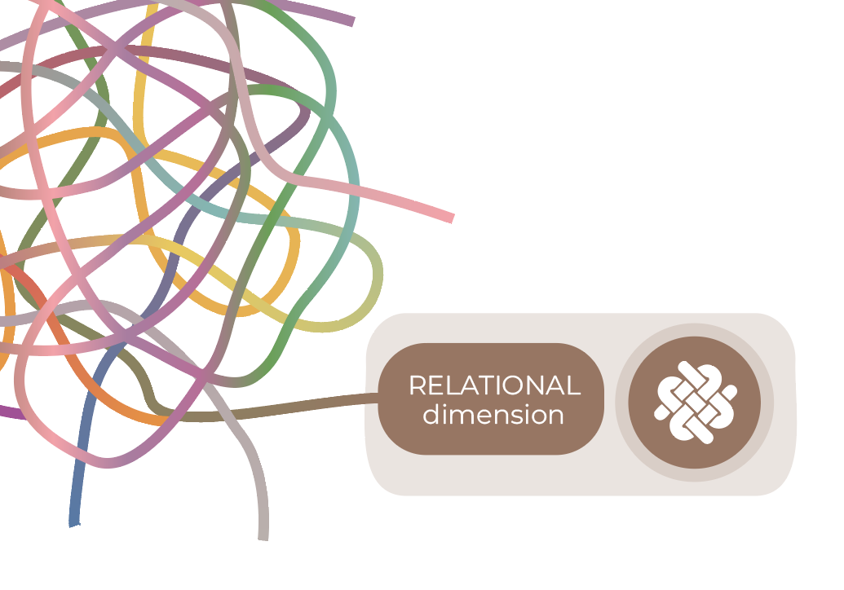
AI-enabled systems mediate our relations with people, institutions, infrastructures, and the other-than-human world—altering the terms of connection, recognition, and responsibility.
PROVOCATION
What kinds of relationships are made possible—or impossible—through AI systems, and on whose terms?
?
Rachel Horst, PhD

Slide 8
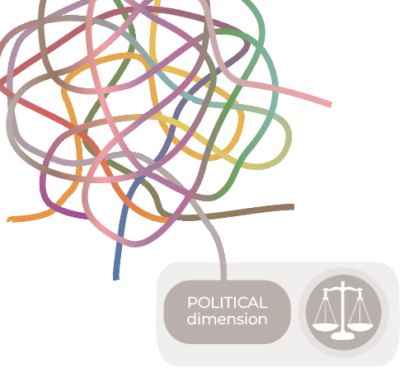
PROVOCATION
?
AI is embedded in systems of governance, economics, and public decision-making, shaped by policies, politics, and profit.
What do terms of service, documentation, and model cards reveal—and conceal—about how AI systems operate and are governed?
How can users critically navigate these texts to understand power, accountability, and control?
Rachel Horst, PhD

Slide 9
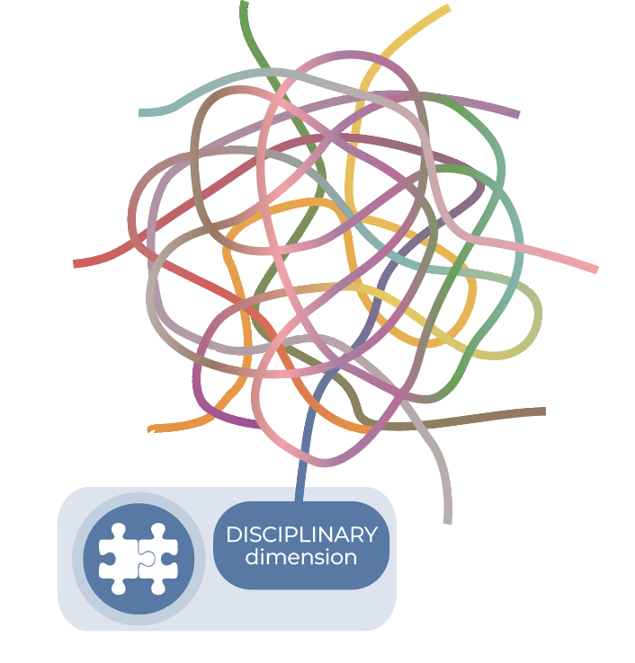
PROVOCATION
How do different disciplines structure problems, select methods, and validate knowledge in relation to AI?
What assumptions underlie disciplinary applications of AI—and how can interdisciplinary approaches expose or reconfigure those assumptions?
AI is being adopted and conceptualized differently across disciplines, creating opportunities for shared learning and critical exchange.
?
Rachel Horst, PhD

Slide 10
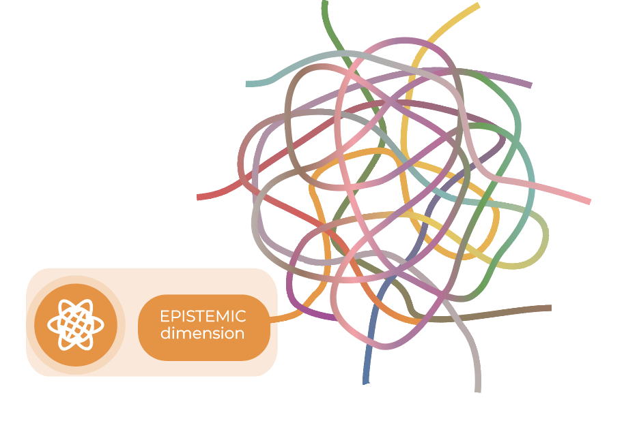
PROVOCATION
AI raises questions about how knowledge is defined, who gets to define it, and what ways of knowing are privileged.
How do AI systems encode epistemic assumptions—about truth, evidence, coherence, or relevance—and how might these reshape our understanding of what it means to know?
?
Rachel Horst, PhD

Slide 11
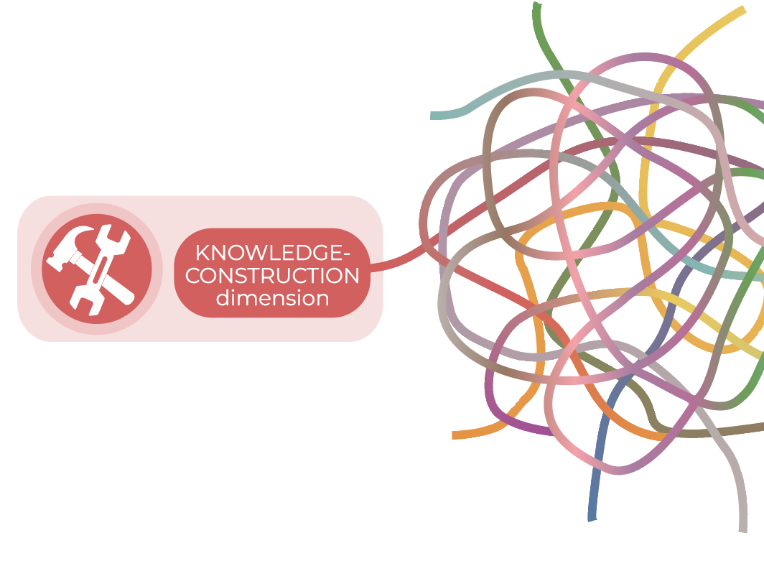
PROVOCATION
Building knowledge with AI requires understanding how information is searched for, produced, organized, and evaluated in the construction of knowledge.
What can we learn about knowledge itself by learning to converse well with AI?
How do prompting practices surface assumptions about relevance, authority, sourcing, and the structures through which knowledge is assembled?
?
Rachel Horst, PhD

Slide 12
This framework is the focus of an academic position paper I’m currently developing. It draws on feminist posthumanist theory as well as a situated review of AI literacy discourse—across scholarly work and the interdisciplinary conversations unfolding in this space. If you have thoughts, ideas, or suggestions, I’d love to hear from you.
Please feel free to use or adapt the materials with attribution.
Full framework and graphics: https://github.com/rshorst/Entangled-Dimensions-of-AI-Literacy
Licensed under Creative Commons Attribution 4.0 International (CC BY 4.0)
Rachel Horst, PhD rachelhorst.ca

